Slide 1



NATIONAL RESEARCH CENTRE
«KURCHATOV INSTITUTE»
PETERSBURG NUCLEAR PHYSICS INSTITUTE
Russia, 188300, Leningrad District ^{, Gatchina, Orlova Roscha}
WP3 PIK collaboration
WP3 Task 3.4:
General blueprint for the instrumentation at PIK
CREMLIN+ WP3 KICK-OFF Meeting|26 June 2020

Slide 2
NATIONAL RESEARCH CENTRE
«KURCHATOV INSTITUTE»
PETERSBURG NUCLEAR PHYSICS INSTITUTE
Russia, 188300, Leningrad District ^{, Gatchina, Orlova Roscha}
Based on the outcome of the CREMLIN project it was decided that additionally to the national Russian instruments, 5 new neutron instruments will be designed and built in Germany and then installed at the reactor PIK.
Partners will carry out extensive simulation work to define the optimal positioning of both Russian and German instruments on the neutron beams and provide the conceptual design of the neutron blueprint accounting for specific features of the cold sources.
This work will be done under the supervision of the instrumental subcommittees of the PIK-SAC (to be realised within task 3.6) that will provide recommendations aiming maximal complementarity of Russian and international neutron instruments.
CREMLIN+ WP3 KICK-OFF Meeting|26 June 2020

Slide 3
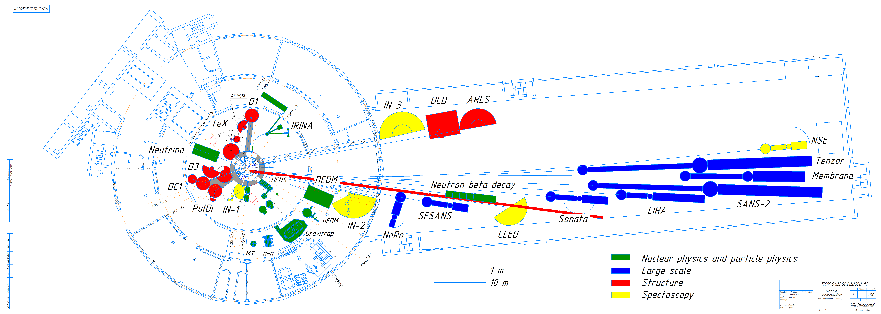


Slide 4
NATIONAL RESEARCH CENTRE
«KURCHATOV INSTITUTE»
PETERSBURG NUCLEAR PHYSICS INSTITUTE
Russia, 188300, Leningrad District ^{, Gatchina, Orlova Roscha}
Important dates for the 1st phase
01.08.2020 Start of the project
01.02.2021 Definition of optimal suite of instruments
01.08.2021 Primary layout of NGs & instruments in the PIK guide hall for optimal instrument suite
After that – detailed calculations for the selected suite with fixed CNS design
CREMLIN+ WP3 KICK-OFF Meeting|26 June 2020

Slide 5
NATIONAL RESEARCH CENTRE
«KURCHATOV INSTITUTE»
PETERSBURG NUCLEAR PHYSICS INSTITUTE
Russia, 188300, Leningrad District ^{, Gatchina, Orlova Roscha}
12.06.2020 VC meeting
Each partners’ plans
Coordination with tasks 3.1 and 3.2
Preparing for the start of the project
CREMLIN+ WP3 KICK-OFF Meeting|26 June 2020

Slide 6
NATIONAL RESEARCH CENTRE
«KURCHATOV INSTITUTE»
PETERSBURG NUCLEAR PHYSICS INSTITUTE
Russia, 188300, Leningrad District ^{, Gatchina, Orlova Roscha}
List of instruments
SANS HZG
Reflectometer FZJ
PD TUM + LLB(observer)
TAS PNPI
TOF PNPI + TUM
NSE FZJ
Will be updated as the time goes on
Will be presented at the subcommittees’ meetings
CREMLIN+ WP3 KICK-OFF Meeting|26 June 2020

Slide 7
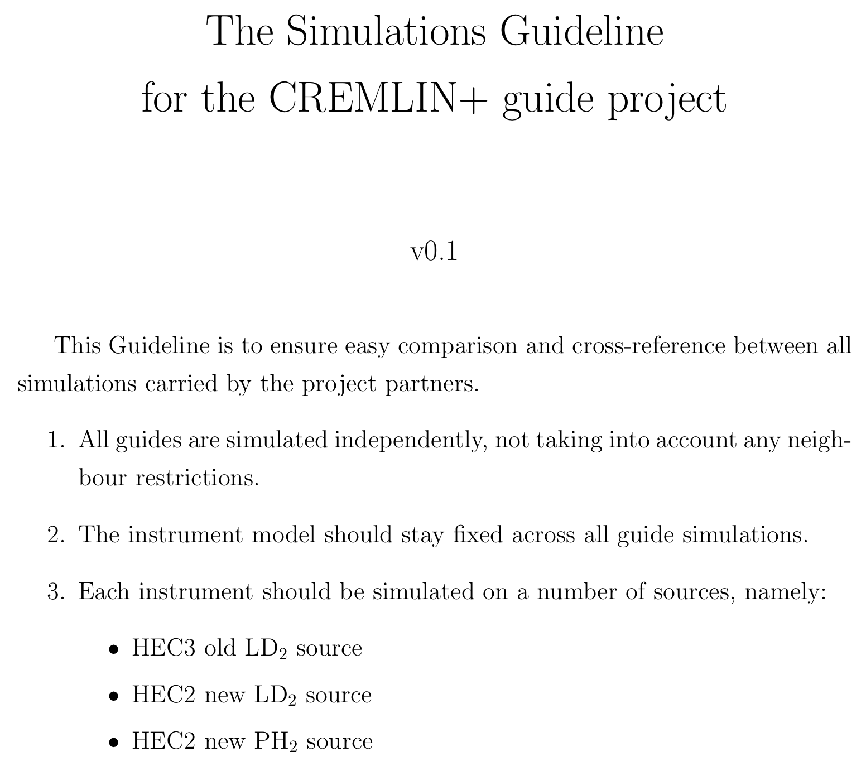
NATIONAL RESEARCH CENTRE
«KURCHATOV INSTITUTE»
PETERSBURG NUCLEAR PHYSICS INSTITUTE
Russia, 188300, Leningrad District ^{, Gatchina, Orlova Roscha}

Slide 8
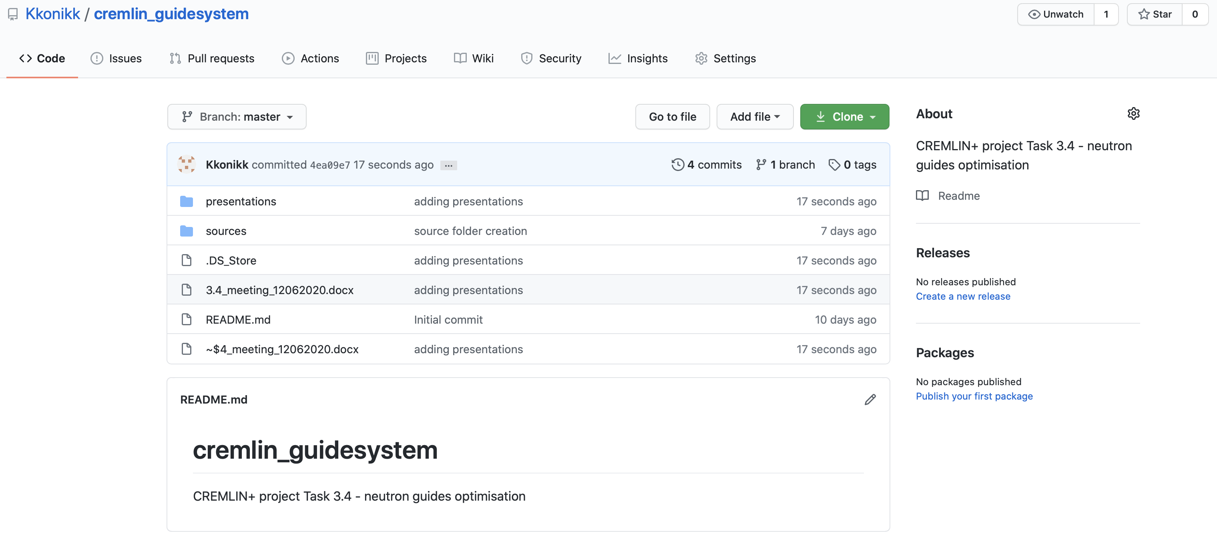
NATIONAL RESEARCH CENTRE
«KURCHATOV INSTITUTE»
PETERSBURG NUCLEAR PHYSICS INSTITUTE
Russia, 188300, Leningrad District ^{, Gatchina, Orlova Roscha}
CREMLIN+ WP3 KICK-OFF Meeting|26 June 2020

Slide 9
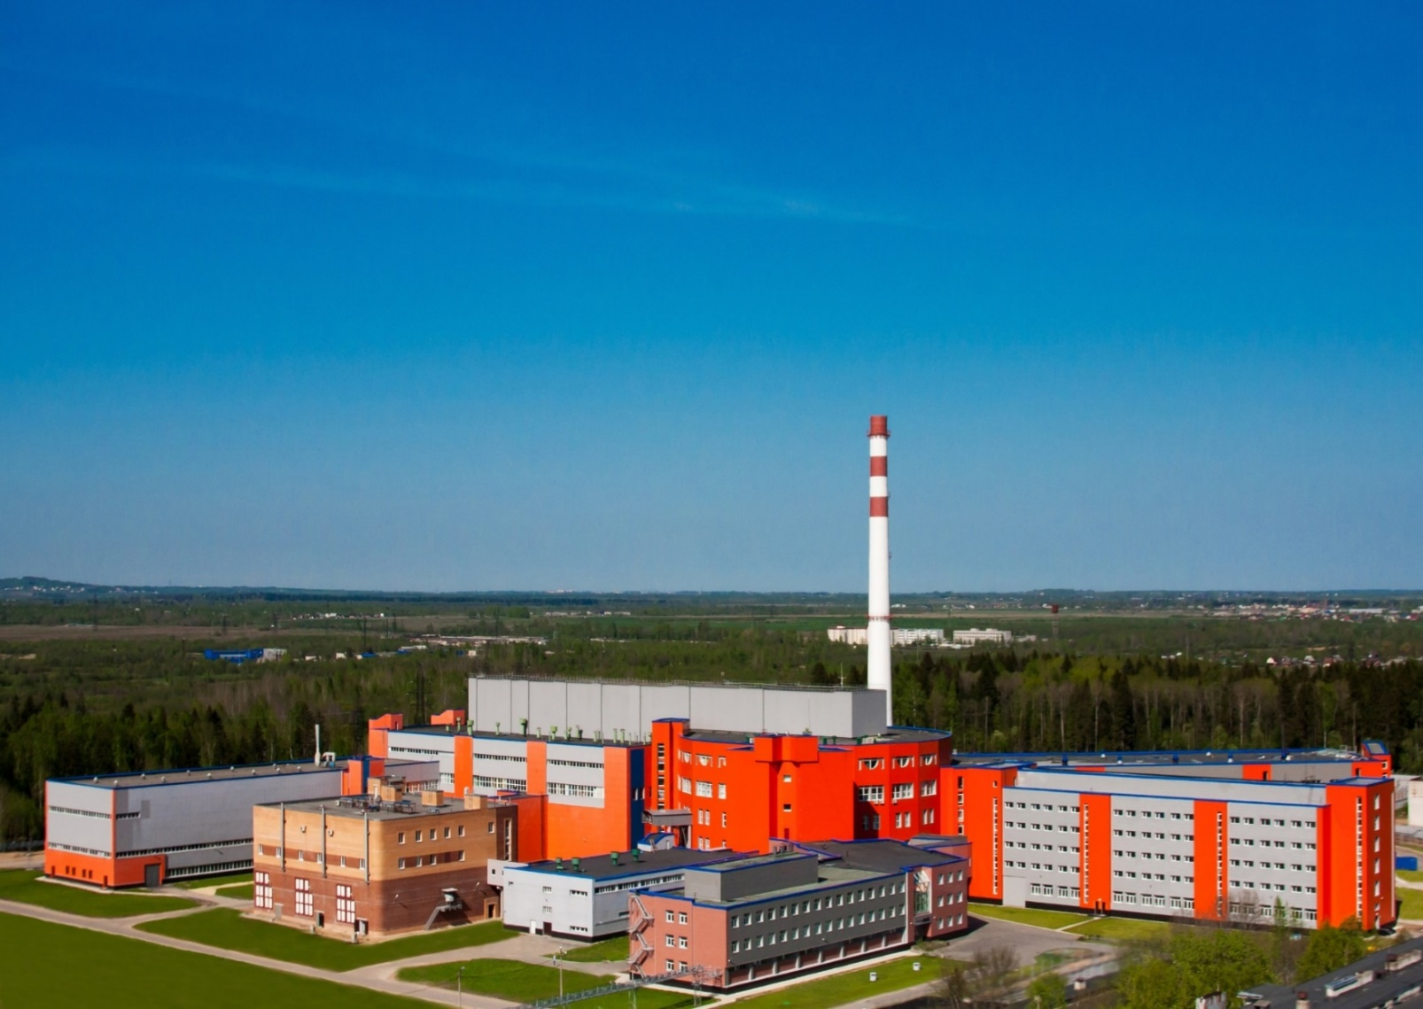
Thank you for attention!
CREMLIN+ WP3 KICK-OFF Meeting|26 June 2020

